Slide 1
Car Accidents In The UK
Tomer Volk & Or Berman

Slide 2
The Data
Car Accidents in the UK in 2015
Contains ~300,000 data points
Each datapoint has ~70 features

Slide 3
Data Preprocess
We chose the main features as our confounders: light, day of week, etc.
The rest are considered hidden (special conditions) or post treatment (number of casualties)
We down sampled the not severe class to reach a 2:1 ratio

Slide 4
Research Questions
The outcome: is severe / num casualties (single or plural)
We would check the effects of various variables such as:
Light and weather conditions
Sex and age of the driver
Vehicle age

Slide 5
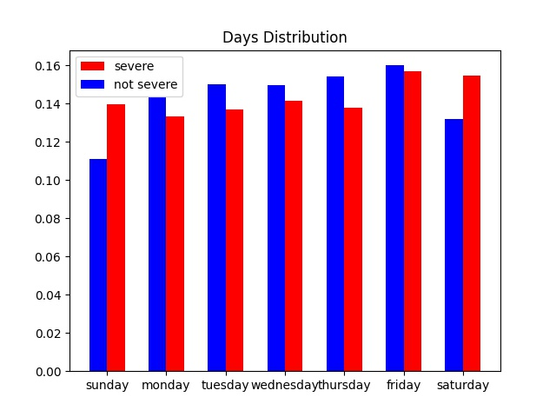
Some graphs

Slide 6
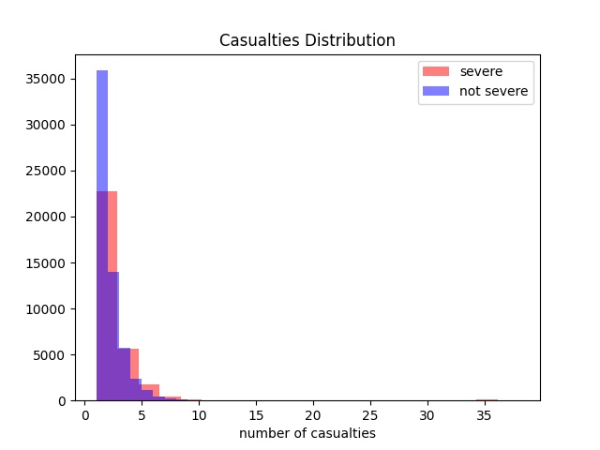

Slide 7
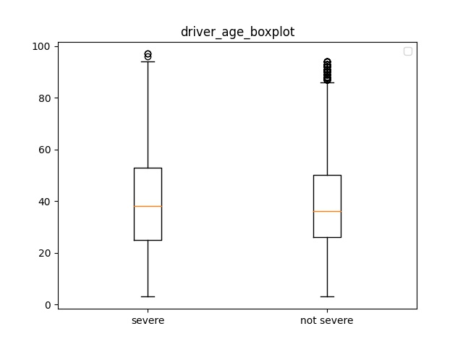

Slide 8
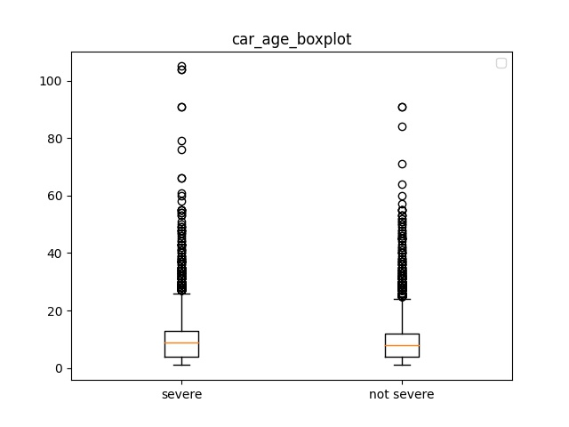

Slide 9
Some Stats
49.89% of the severe accidents are in urban areas
65.16% of the not severe accidents are in urban areas
In 62.27% of the severe accidents the first impact is frontal
In 47.16% of the not severe accidents the first impact is frontal

